Slide 1
Central Lane Metropolitan Planning Organization Scenario Planning
Kelly Clarke, AICP Senior Transportation Planner

Slide 2
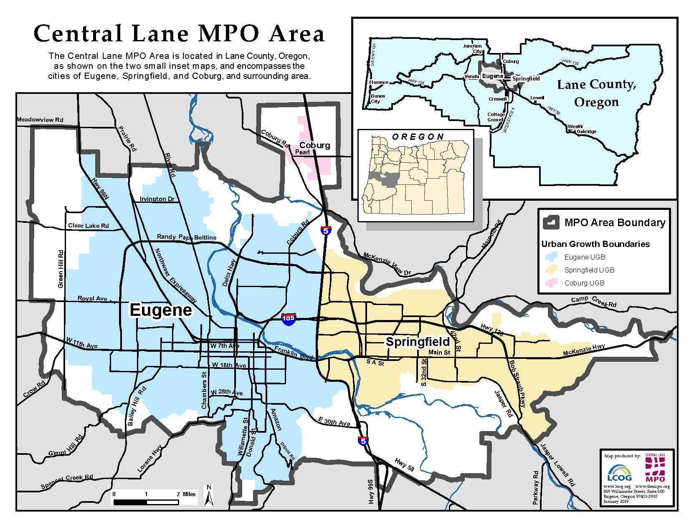
Lane Council of Governments (LCOG) Central Lane Metropolitan Planning Organization (CLMPO)
City of Eugene
City of Springfield
City of Coburg
Lane County
Lane Transit District
Notes:
120 miles south of here on I-5
Approximately 260,000 people

Slide 3
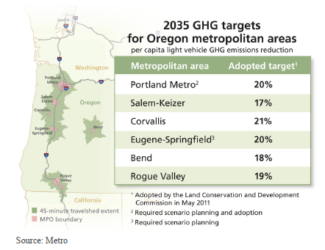
Oregon Sets a Goal
Senate Bill 1059:
..the Oregon Transportation Commission...shall adopt a statewide transportation strategy on greenhouse gas emissions to aid in achieving the greenhouse gas emissions reduction goals set forth in ORS 468A.205 [a 75 percent reduction below 1990 levels by 2050]..
2035 target created in order to make achieving the 2050 reduction goal realistic
2050 per capita emissions roughly 12% of 1990 per capita emissions
CLMPO target for 2035 is 20% per capita reduction
Notes:
Our work with scenario planning began when the Oregon Legislature set a goal.
Overall, the state of Oregon aims to reduce greenhouse gas emissions by 75% over 1990 levels by 2050. In pursuit of that goal, the state identified targets 2035 for each metro area. Our target is a 20% reduction over 1990 levels. While the region is not required to meet this target, we were required to go through a scenario planning process and demonstrate a strategy to meet that target.

Slide 4
CLMPO Scenario Planning: Pathways to Meet the State’s GHG Reduction Goal
Initiate a scenario planning process
Partners
Cities of Eugene, Springfield, Coburg
Oregon Department of Transportation
Lane Transit District
Lane County
Models used
Regional Strategic Planning Model (RSPM)
Integrated Transportation Health Impact Model ( ITHIM)

Slide 5
Evaluating the Target
Central Lane region 2035 GHG emissions reduction target in per capita terms
Where We Need to Go
Where We Are
2005
2005 = 3.62 MTCo₂e
2010
2010 = 3.49 MTCo₂e
Adopted 2035 Plans and Policies with Future Fleet, Technology and Fuels = 1.32 MTCo₂e
Region’s Target = 1.08 MTCo₂e
2035
Additional 17% Reduction Needed Using:
_{Community Design}
_{Marketing & Incentives}
_{Pricing}
2050
Notes:
First we evaluated our existing plans and polices and found that we were close to our target but not all the way there. We needed to achieve another 17% reduction using strategies including community design, marketing and incentives and pricing.

Slide 6
Central Lane Scenario Planning goals
Economic vitality
Health
Equity
Greenhouse gas reduction
Flexibility for jurisdictions in the region
Notes:
The region has determined that scenarios should:
Enhance the region’s economy
Improve health
Improve equity for all residents in the region
While reducing greenhouse gases
Scenarios should also provide flexibility for jurisdictions in the region to take different paths to achieve these goals.

Slide 7
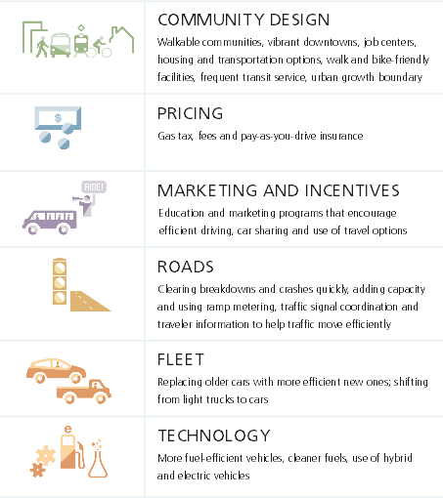
Strategies Evaluated
Notes:
Community Design:
Walkable communities, Vibrant downtowns, Job centers, Housing, Transportation choices,
Pricing
Gas tax, fares, Pay-as-you drive insurance
Marketing and Incentives
Education and marketing programs encouraging efficient driving, car sharing and travel options
Roads
Clearing breakdowns and crashes quickly, adding capacity, Intelligent transportation systems
Fleet
Replacing older cars with more efficient ones, Shifting from light trucks to cars
Technology
More fuel efficient vehicles, Cleaner fuels, Use of hybrid and electric vehicles

Slide 8
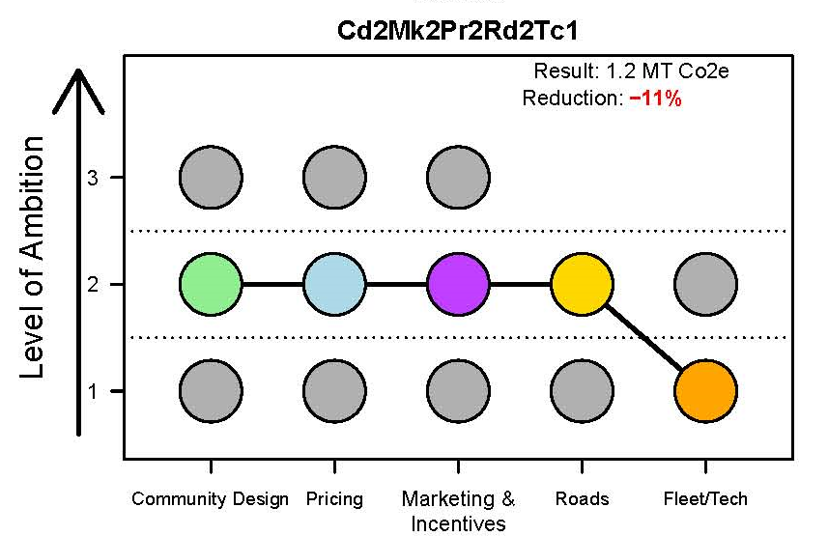
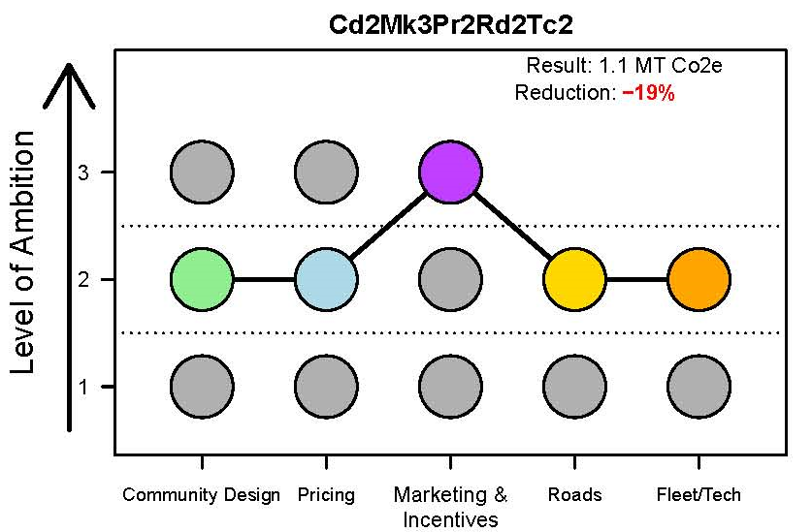
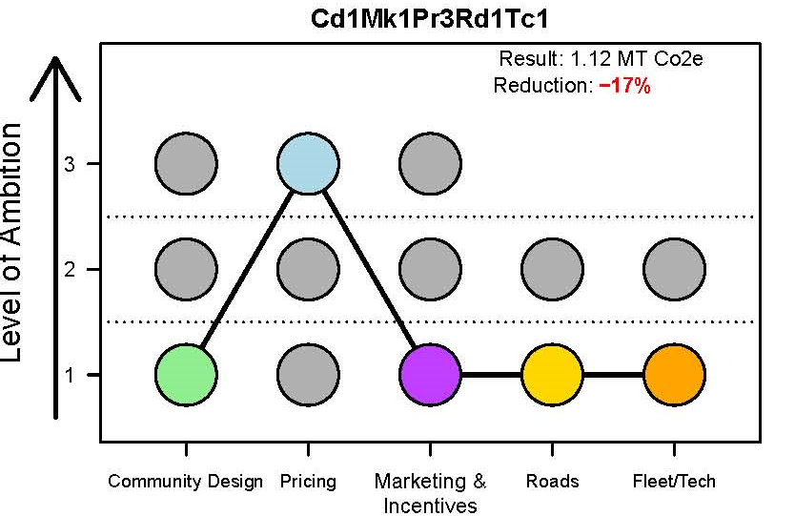
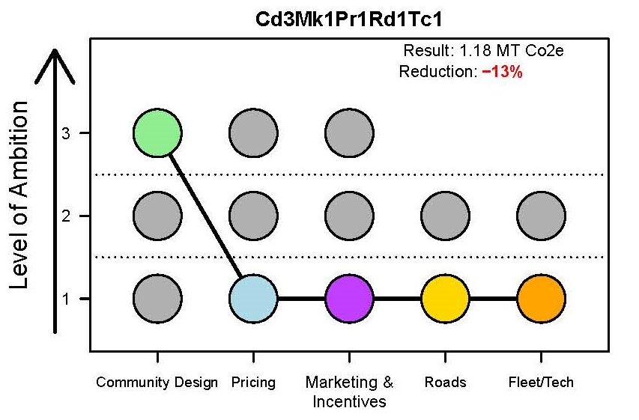
Policy Bundles
Level 1 – Reference Case: Shows the results of implementing adopted plans or recent policy direction.
Level 2 – More Ambitious: Shows the results of maximizing actions that are consistent with recent policy direction but go beyond what we can expect to achieve without new revenues or other action.
Level 3 – Most Ambitious:
Shows the result of new policies or actions that may build on existing policy direction or explore new actions
Strategies Evaluated
Notes:
To test how we might get there and what the outcomes of those alternative futures might be, the project team developed three levels to classify scenarios –
Level 1 – Reference Case: Shows the results of implementing adopted plans or recent policy direction.
Level 2 – More Ambitious: Shows the results of maximizing actions that are consistent with recent policy direction but go beyond what we can expect to achieve without new revenues or other action.
Level 3 – Most Ambitious:
Shows the result of new policies or actions that may build on existing policy direction or explore new actions
Scenarios within levels 2 and 3 allowed us to ask “what if” before we agreed on policies or strategies that make sense for our region.

Slide 9
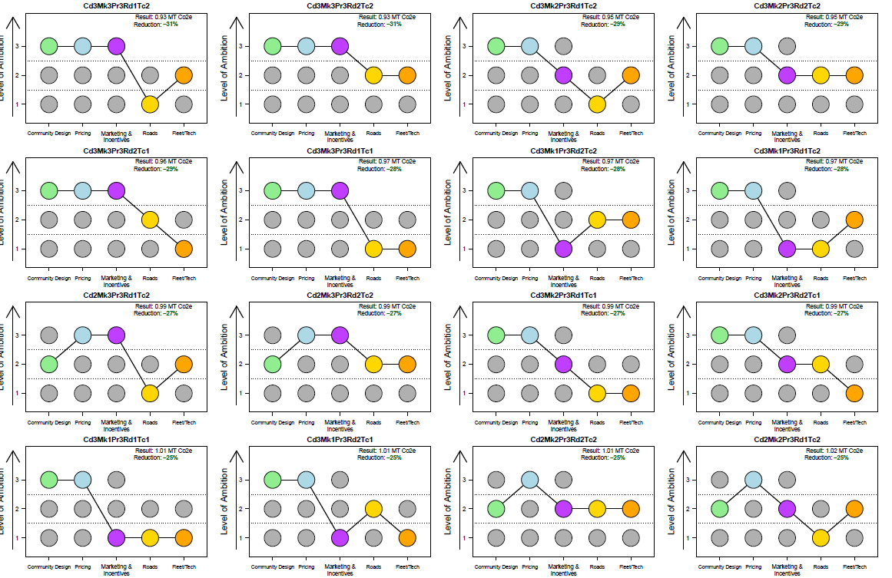
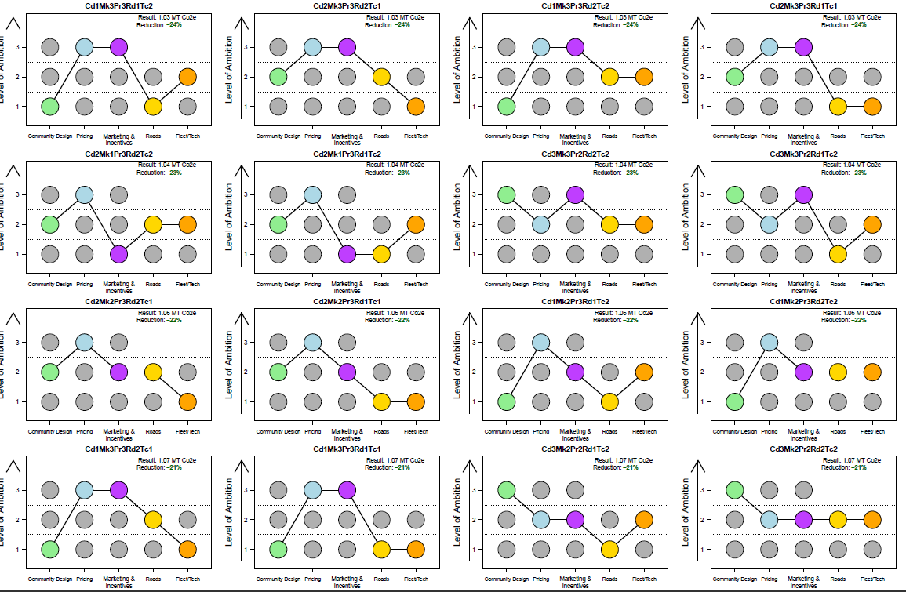
Outcomes
Many ways to meet the state target (42 out of 108), 15 of those meet the target without additional changes to vehicle fleet and technology
No one strategy or bundle can make the target
Level/Scenarios are meant to be informative rather than prescriptive. Some strategies were not tested with realistic implementation expected.
Policies can interact with one another. They can compliment or contradict other policies.
Notes:
Supported our regional goals of:
1. A Compact urban form
2. To Divert more trips to biking and transit and provide more choices
- New biking and walking facilities
- More education and marketing to drive behavior change
3. Make improvements to make our road system work more efficiently

Slide 10
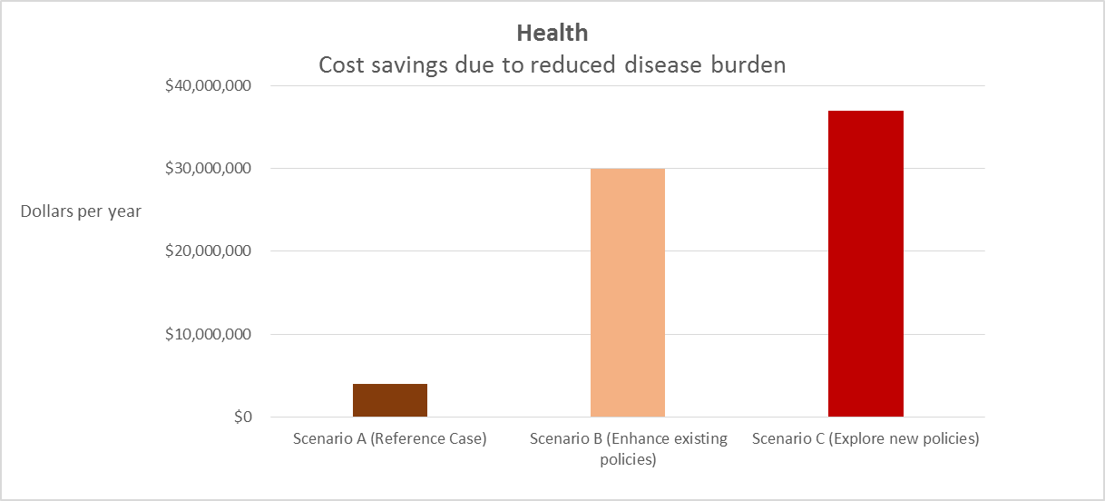
Alternative scenarios: public health
Increases in active transportation result in cost savings
Savings equate to about $250 per household each year
Notes:
So, we learned that we can improve health and the economy by reducing time lost to congestion, getting more people to bike and walk and improving air quality. We can increase local revenues for transportation and meet the state’s greenhouse gas reduction target.
The short answer is that if health care costs rise fast than inflation (and presumably incomes) we ultimately will be putting more and more of our household expenditures towards health care which would be less productive for the economy overall.
Improve health and the economy
Increase local revenues for transportation
Mitigate impact of increased driving costs
Meet the state’s greenhouse gas reduction target

Slide 11
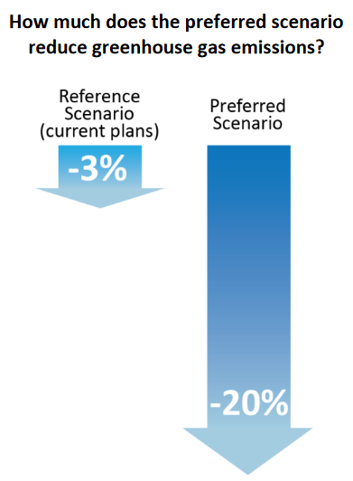
Preferred Scenario
A balanced approach towards investment in:
Active Transportation
Fleet and Fuels
Transit
Pricing
Parking Management
Education and Marketing
Roads
Notes:
The region developed a preferred scenario with recommendations from each strategy:
A significant investment in transit, active transportation, and education and marketing programs
Some change in the way drivers pay to use the system
Continued investment in optimizing roadways in the region
Continued support for the state’s assumptions about changes to vehicle and fuel technology
Continued policies related to parking pricing and availability
The plan contains strategies to achieve these investment areas.
The plan called for new revenue sources to support the preferred scenario.
That was presented to the state, fulfilling our requirement to go through a scenario planning process and select a preferred scenario to show how our region could support the state’s GHG targets.

Slide 12
Lessons learned
Current plans are headed in the right direction
Looking at a variety of goal areas is important to local decision makers
Greenhouse gas reduction target is difficult to communicate
Scenario planning is best integrated into other planning processes (Regional Transportation Plan, comprehensive planning, etc.)
Requiring an unfunded mandate is not popular
Notes:
This plan and its strategies are now available to help guide future decision making. Our region was not required to implement the preferred scenario. Metro, Portland area, was the only region required to adopt a preferred scenario and implement it).

Slide 13
City of Eugene Climate Recovery Ordinance and Transportation System Plan
City of Eugene Climate Recovery Ordinance Goals:
Reduce fossil fuel use by 50% by 2030
By the year 2100, total community greenhouse gas emissions shall be average share of a global atmospheric greenhouse gas level of 350 ppm, which is estimated in 2016 to require an annual average emission reduction level of 7.6%.
City of Eugene Transportation System Plan Goal:
Triple Bike, Pedestrian and Transit Mode shares by 2035.
Notes:
Varied interest in this work since completed in 2015.
Since that time, Eugene adopted a Climate Recovery Ordinance with the goals to:
Reduce fossil fuel use by 50% by 2030
By the year 2100, total community greenhouse gas emissions shall be average share of a global atmospheric greenhouse gas level of 350 ppm, which is estimated in 2016 to require an annual average emission reduction level of 7.6%.
AND adopted a Transportation System Plan with the goal of tripling Bike, Pedestrian and Transit Mode shares by 2035.
We helped Eugene to understand how far their existing plans and policies went towards achieving these goals.
Started with our scenario planning work and the reference case inputs used in the Regional Strategic Planning Model.

Slide 14
Tested Three Scenarios
Scenario | Description | Examples of Inputs
2035 Adopted Plans | Models the adopted ETSP, regional and state* goals, policies, programs and projects. | Bike trips: 24% (models the ETSP goal of tripling bike trips) Workplace TDM: 6% (proportion of working age persons anticipated to work for employers with strong commute options) Light trucks: 48% (percentage of light trucks as share of household vehicles)
2035 What If #1 | Tests a moderately aggressive increase to the adopted goals, policies, programs and projects. | Bike trips: 24% (maintains an already aggressive percentage) Workplace TDM: 10% Light trucks: 39%
2035 What If #2 | Tests an aggressive increase to the adopted goals, policies, programs and projects. | Bike trips: 24% (maintains an already aggressive percentage) Workplace TDM: 25% Light trucks: 30%
* Goals, policies, programs and projects from state and regional plans are considered in the analysis due to the regional geography of RSPM and to the broader impacts of state and regional strategies.
Notes:
We tested three scenarios:
Eugene and the region’s adopted plans
A “what if” scenario pushing adopted plans
A second “what if” scenario pushing the adopted plans further
There were some challenges with the data and inputs since predicting GHG reductions are go beyond the City’s control. There are state, regional and privately driven strategies that will impact emissions coming from the transportation sector.
Statewide incentives for fuel efficient vehicles, pay as you drive insurance and gas costs are all beyond the city’s control.

Slide 15
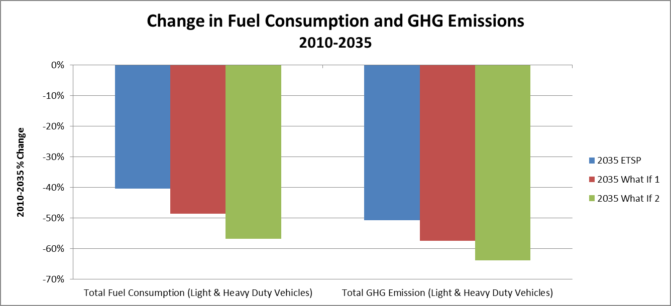
Eugene CRO and TSP Results
Notes:
The “Adopted Plans” scenario and both “What If” scenarios all indicate that a reduction in fuel consumption and GHG emissions could result from implementation of the ETSP, regional and state goals, policies, programs and projects; particularly investments in increasing walking and bicycling, encouraging Transportation Options programs and increasing parking costs. The “What If Scenario 2” represents the largest reduction in fuel consumption and GHG emissions reduction resulting from goals, policies, programs and projects that are more aggressive than those adopted in the ETSP, regional and state plans, including; parking management policies to increase coverage and costs, increased Transportation Options programs, local fuel tax increases, increase in transit service miles, as well as policies to increase walking and bicycling.
City presented this to their council and continues to work towards these goals.

Slide 16
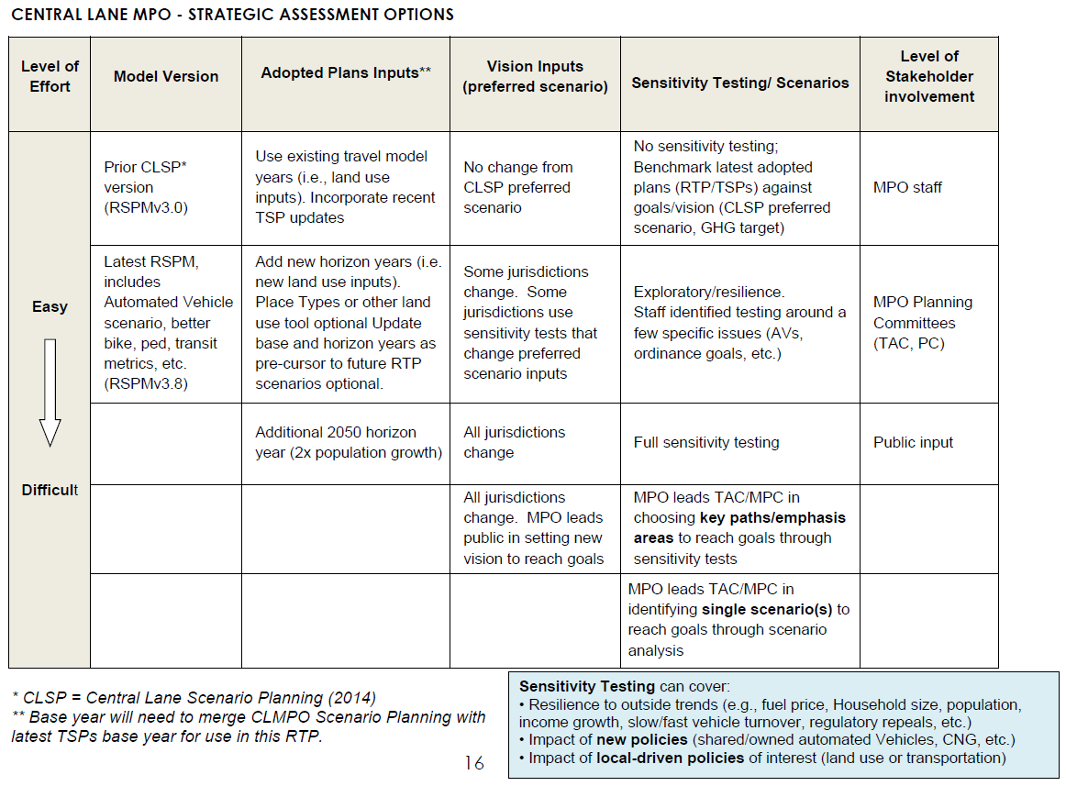
This Brings Us to Today: Strategic Assessment
Notes:
Strategic assessment began with conversations with the state land use department (Department of Land Conservation and Development) and ODOT and wanting to further the work done with scenario planning and Eugene’s TSP as CLMPO prepares to update our Regional Transportation Plan.
We have a memorandum of understanding with our three agencies that outlines this second easy level of effort:
Use VisionEval – the next iteration of RSPM
Based upon the results of our CLSP and ETSP findings.
Add new horizon years – from 2035 to 2040
Work with partners to do sensitivity testing around specific issues and comparing those to the preferred scenario
We have a TAC including our jurisdictional partners.

Slide 17
CLMPO Strategic Assessment
Package/Module |  | Category | Input | Description
VESimHouseholds/CreateHouseholds.R | a | demog | azone_hh_pop_by_age.csv | Number of Household persons within 6 age groups by year by Azone
VESimHouseholds/CreateHouseholds.R | a | demog | azone_gq_pop_by_age.csv | Number of Non-Institutional Group Quarters persons by 6 age groups by year by Azone
VESimHouseholds/CreateHouseholds.R | a | demog | azone_hhsize_targets.csv | Average household size & share of 1-person households by year by Azone
VESimHouseholds/PredictIncome.R | a | demog | azone_per_cap_inc.csv | Annual Per Capita Income by type (HH, GQ) by Year by Azone
VEHouseholdVehicles/AssignDrivers.R | d | demog | region_hh_driver_adjust_prop.csv | (optional) Licensed share of driving age persons in 5 age groups relative to model estimation year (2001 NHTS) by year modelwide (default =1.0)
VESimHouseholds/PredictWorkers.R | d | demog | azone_relative_employment.csv | (optional) Employed share of Household workers in 5 age groups relative to model estimation yeaer (2001 NHTS) by year by Azone (default is 1.0)
VELandUse/PredictHousing | a | land use | bzone_hh_inc_qrtl_prop.csv | Share of Dwelling Units (HHs) in Per Capita Income quartiles by year by BZone
VELandUse /LocateEmployment | a | land use | bzone_employment.csv | Number of Total, Retail, and Service employment by year by Bzone
VELandUse/PredictHousing | a | land use | bzone_dwelling_units.csv | Number of Dwelling Units by type (SF, MF, GQ) by Year by Bzone
VELandUse/AssignLocTypes | a | land use | bzone_urban-town_du_proportions.csv | Share of Bzone Dwelling units (SF, MF, GQ) within urban and town location types by year (town unlikely to be used in Oregon MPO applications of VE-RSPM)
VELandUse/Calculate4DMeasures | a | land use | bzone_network_design.csv | Design D (D3bpo4, pedestrian-oriented network measure as defined by EPA Smart Location Database) by year by Bzone
VELandUse/Calculate4DMeasures | a | land use | bzone_unprotected_area.csv | Land Area (water and large protected lands removed) by location type (Urban, Town, Rural) by year by Bzone
VELandUse /LocateEmployment | a | land use | bzone_lat_lon.csv | Bzone Centroid Latitute/Longitude by year by Bzone
VELandUse/CalculateUrbanMixMeasure | d | land use | bzone_urban-mixed-use_prop.csv | (optional) Share of HHs in Urban Mixed Use Neighborhoods by Year and Bzone [NHTS Claritas Urban Mixed Use definition]
VEHouseholdTravel/DivertSovTravel.R | a | actions-bikes | azone_prop_sov_dvmt_diverted.csv | Bike, Personal Electric Vehicle. Etc. diversion of Single Occupancy vehicle tours by year by Azone.[In VE-State, applies to "urban" and "town" but not "rural" loc types within the AZone]
VEHouseholdVehicles/AssignVehicleAge.R | a | actions-CarSvc | azone_carsvc_characteristics.csv | Car Service Rate ($/mile) by level (high, low, ave), average Car service vehicle age, and limits on shifting to car service (LtTruck, Auto) by Year by Azone
VELandUse/AssignCarSvcAvailability | a | actions-CarSvc | bzone_carsvc_availability.csv | Car Service Level of service (High, Low) by Year by Bzone
Notes:
Currently preparing data files for our base year of 2010 and horizon year of 2040.
CLMPO staff are being trained on using the VisionEval model and preparing the data inputs.
Operationalize this work into future planning work and be more nimble to respond to this type of request and work.

Slide 18
Analysis Geography
Notes:
VisionEval has a b-zone geography. Our region has 68 b-zones – they are mostly driven by census block group geographies.
It is important for our partners to evaluate policies specific to their jurisdictional boundary.

Slide 19
Focus areas
Equity
Health
Safety
Emissions
Mode Share
Emerging Technologies
Economic Development
Notes:
Our focus areas are: equity, health, safety, emissions, mode share, emerging technologies, economic development
Over the summer: work with TAC to develop scenarios and sensitivities to test.
Findings will guide policy development and be integrated into the RTP.

Slide 20
Questions?

Slide 21
TRB abstract
The Central Lane MPO (CLMPO) led a regional scenario planning effort in 2014 in response to state of Oregon legislative requirements to develop transportation modeling and other technical capabilities needed to estimate emissions and to develop scenarios showing land use and transportation alternatives that result in a reduction of transportation sector GHG emissions. The scenario planning effort resulted in a preferred scenario representing a balanced approach toward investment in seven areas: active transportation, fleet and fuels, transit, pricing, parking management, education and marketing and roads. CLMPO is now programming an update to its current RTP and will utilize updated VisionEval strategic planning model to re-look at the original scenario planning work and to test and quantify what regional policies, programs and investment actions will allow the MPO to achieve its long range planning vision and goals.
As a precursor to guide policy development of the upcoming update of the MPO’s Regional Transportation Plan (RTP), CLMPO will undertake a Strategic Assessment exercise utilizing VisionEval scenario planning tools. CLMPO will test outcomes related to varying scenarios around autonomous vehicles, bicycle, pedestrian and transportation options policies and system investments. Quantified outcomes for daily vehicle miles traveled (VMT), annual auto delay, percent of population in mixed use areas, annual walk and bike trips, greenhouse gas emissions, travel costs, etc will guide a data-based way to inform long range transportation plans and strategies.

